Slide 1
Report on Vulnerabilities found in the target URL http://zero.webappsecurity.com/

Slide 2
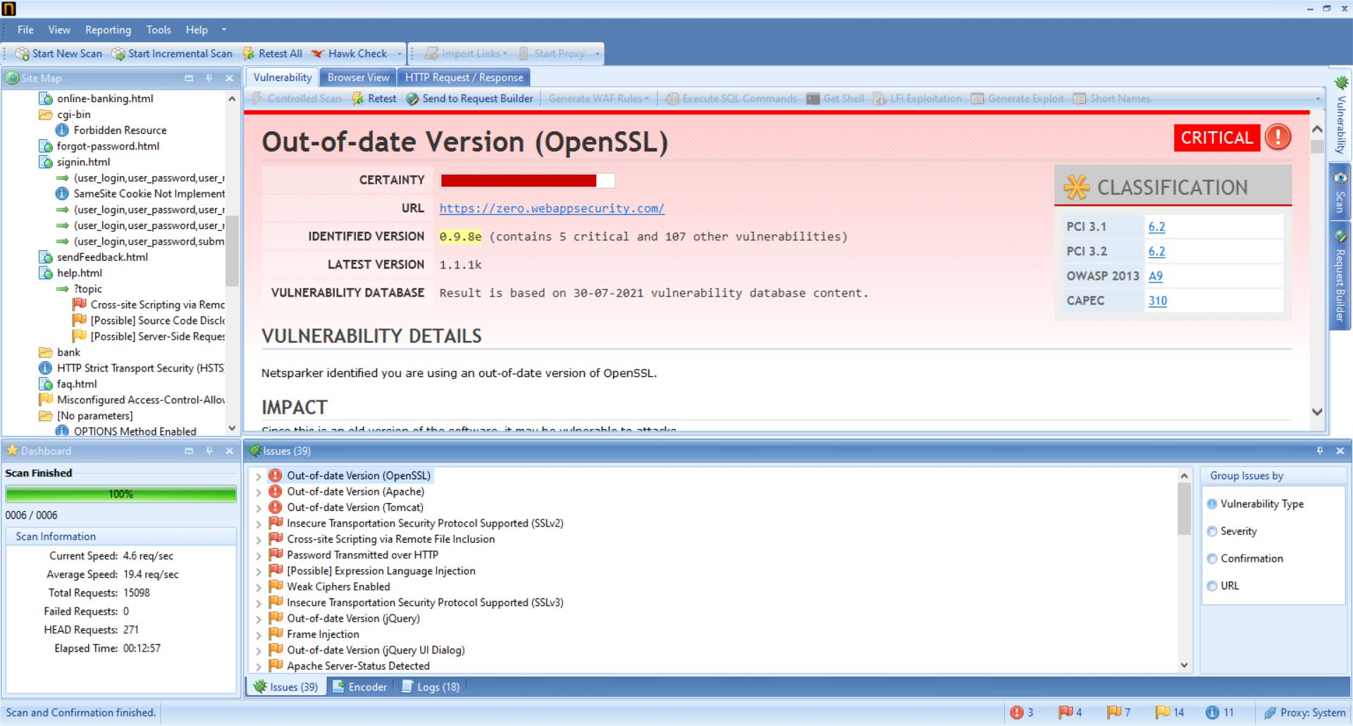
Total issues found = 39

Slide 3
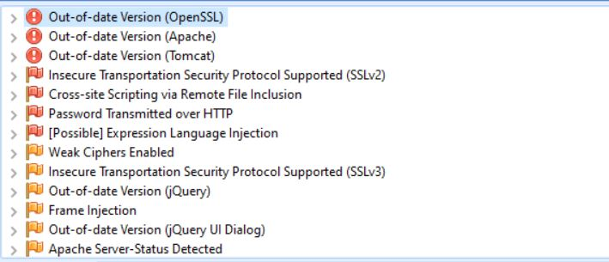
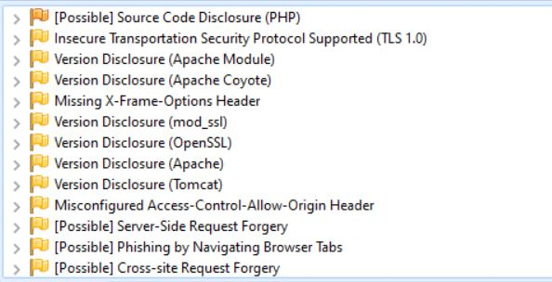
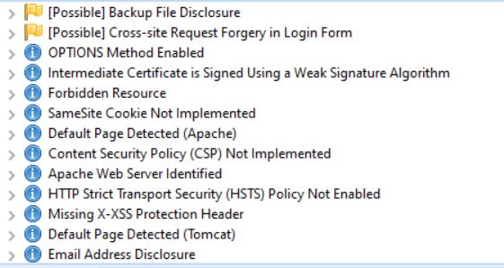
Lists of all vulnerabilities found by Netsparker

Slide 4
Critical Vulnerabilities found:
Out-of-date version (OpenSSL)
Out-of-date version (Apache)
Out-of-date version (Tomcat)

Slide 5
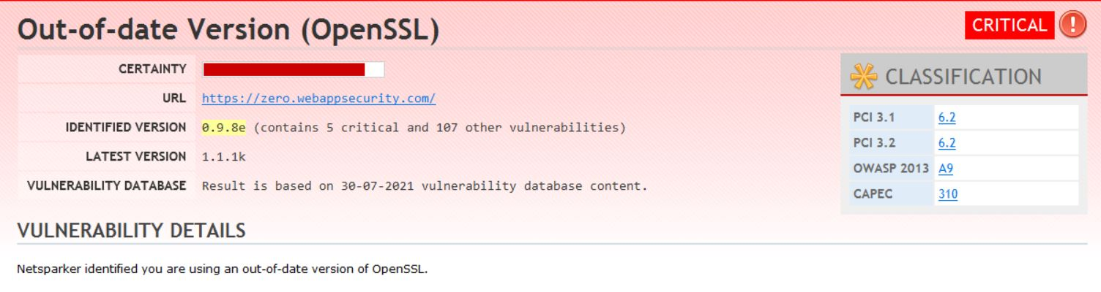
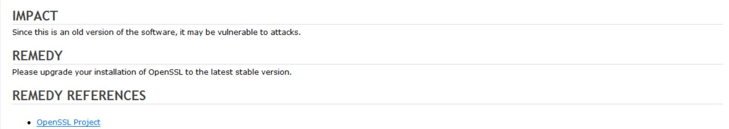
Report generated by NetSparker

Slide 6
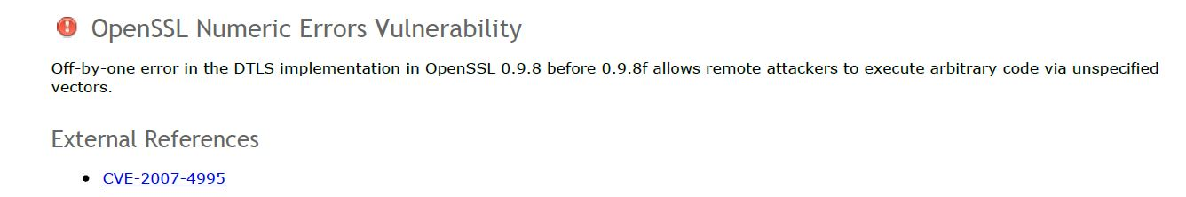
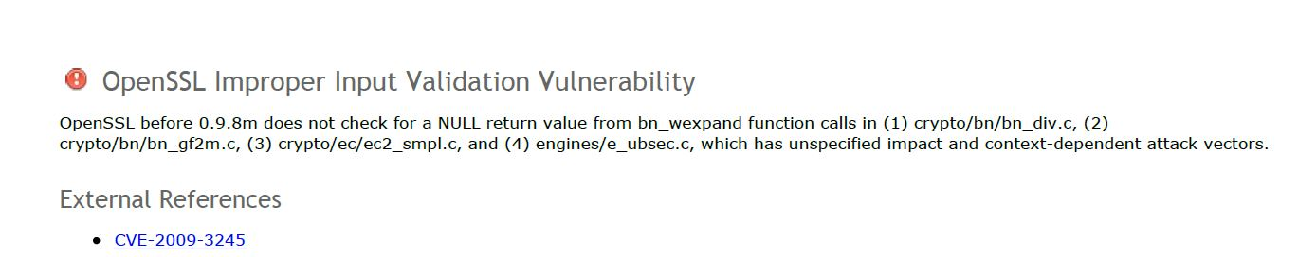
Critical Vulnerabilities found in this Version

Slide 7
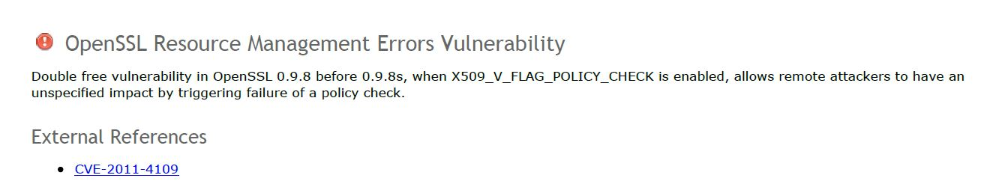
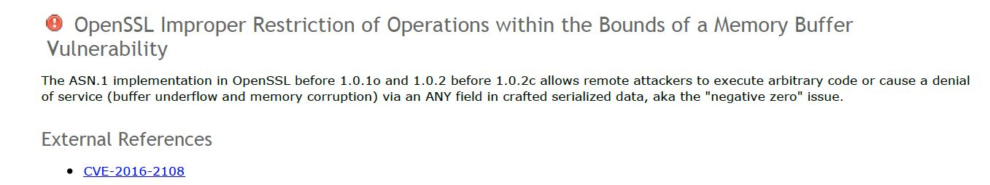

Slide 8
Own Report
Vulnerability Type - Critical
Out-of-date Version (OpenSSL)
Found in URL : https://zero.webappsecurity.com/
Identified Version : 0.9.8e
The identified version contains 5 critical and 107 other vulnerabilities
Latest Version available : 1.1.1k
Vulnerability database : Result is based on 30-07-2021 vulnerability database content.
Vulnerability details
The current version of OpenSSL used by your website is outdated.
Impact
The impact is enormous. Usage of old version makes your site vulnerable to DOS attacks making one lose essential data. Hacker can launch a Man in the Middle attack and snoop on unencrypted data.

Slide 9
Remedy
The best fix for the vulnerability is to upgrade all OpenSSL clients and servers with the above mentioned latest version that apply.
Remedy References
https://www.openssl.org/
Critical Vulnerabilities known in this Version
1) OpenSSL Numeric Errors Vulnerability
Tendency to allow remote attackers who may execute code using unspecified vectors due to off by one error in DTLS implementation.
External reference
https://nvd.nist.gov/vuln/detail/CVE-2007-4995#vulnCurrentDescriptionTitle
2) OpenSSL Improper Input Validation Vulnerability
Unspecified impact and context-dependent attack vectors are there as it does not check for a NULL return value from bn_wexpand function calls.
External reference
https://nvd.nist.gov/vuln/detail/CVE-2009-3245

Slide 10
3) OpenSSL Resource Management Error Vulnerability
Unspecified impact by remote attackers, triggering failure of a policy check, when
X509_V_FLAG_POLICY_CHECK is enabled.
External reference
https://nvd.nist.gov/vuln/detail/CVE-2011-4109
4) OpenSSL Improper Restriction of Operations within the Bounds of a Memory Buffer Vulnerability
Remote attackers may be able to execute arbitrary code or cause a DOS attack as there is a open vulnerability in ASN.1 implementation.
External reference
https://nvd.nist.gov/vuln/detail/CVE-2016-2108

